Slide 1
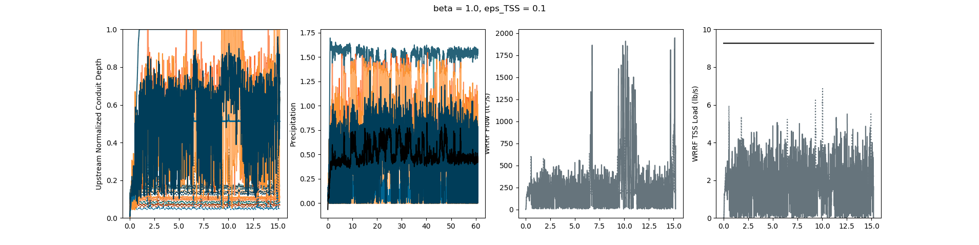
TSS, thres, before change of price equation to include 1.

Slide 2
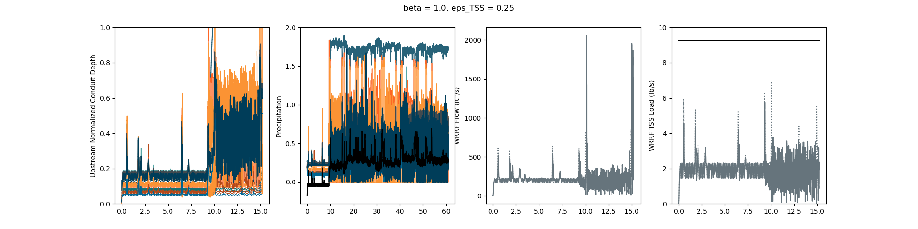
TSS

Slide 3
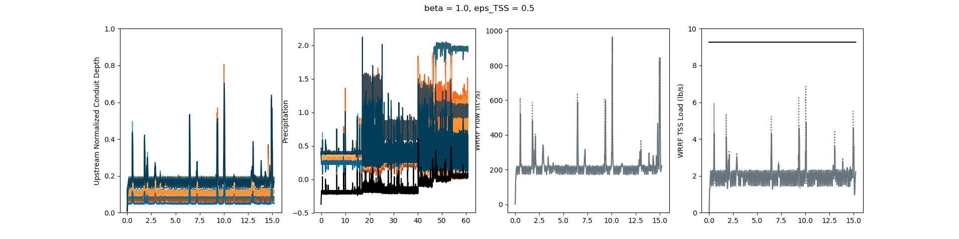
TSS

Slide 4
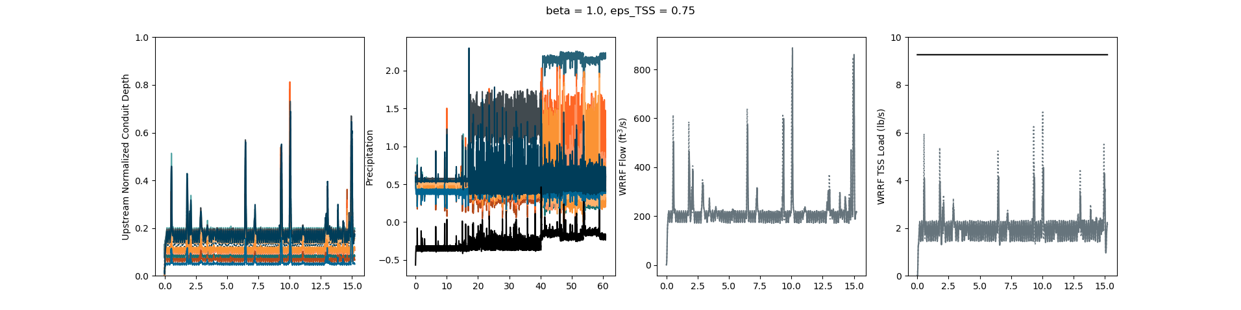
TSS

Slide 5
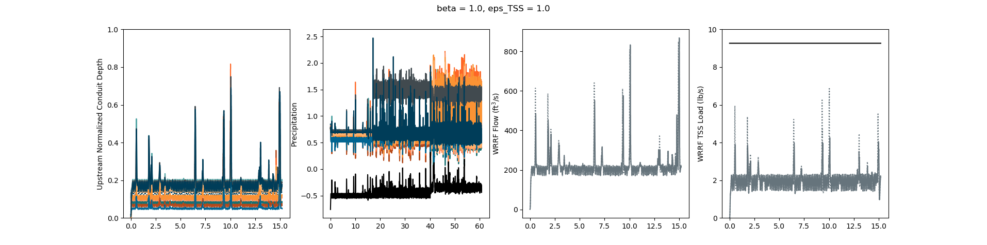
TSS

Slide 6
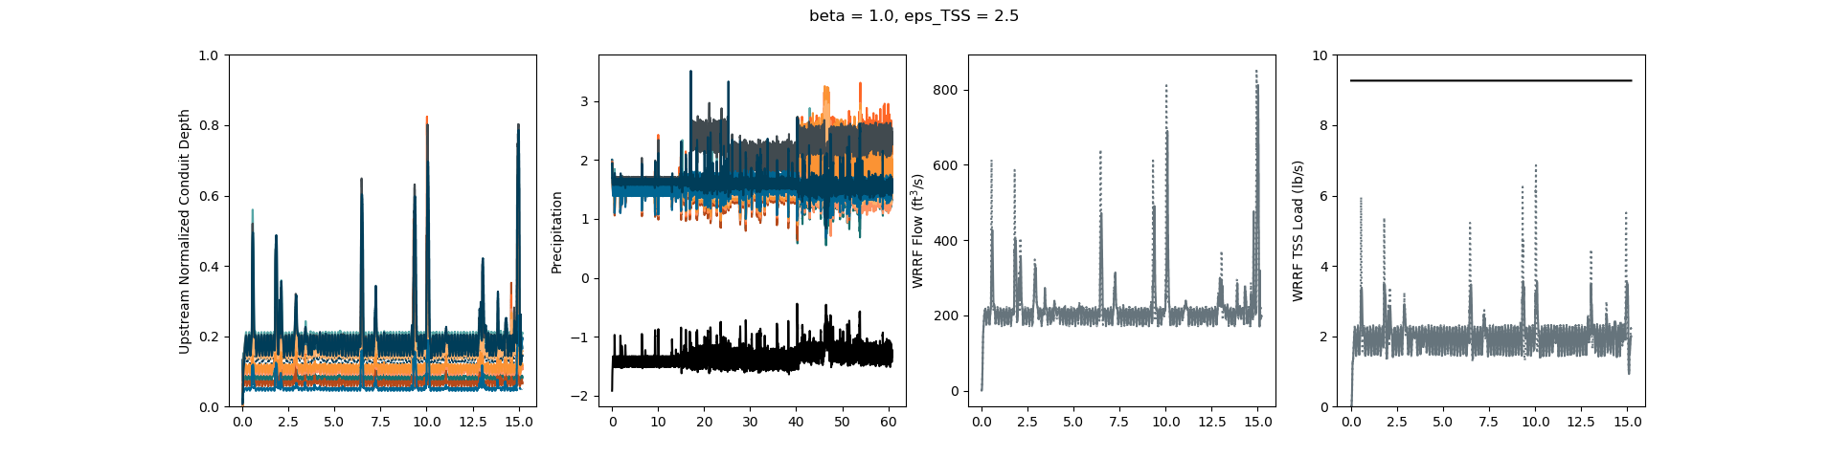
TSS

Slide 7
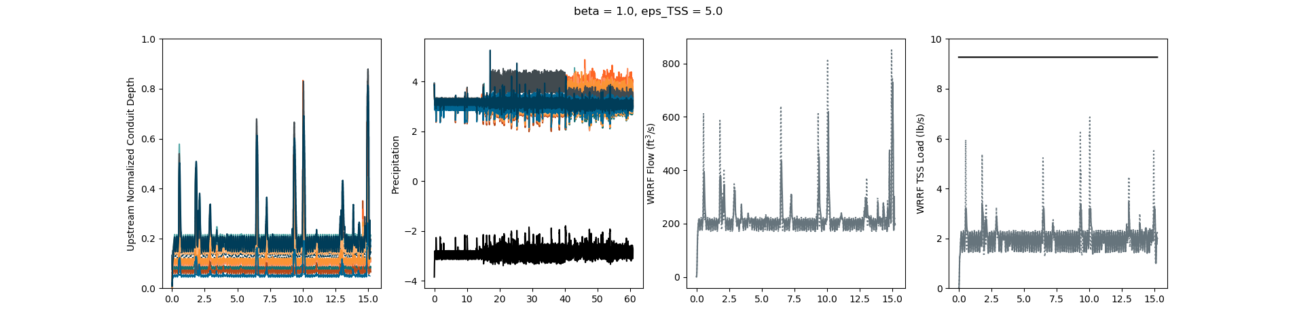
TSS

Slide 8
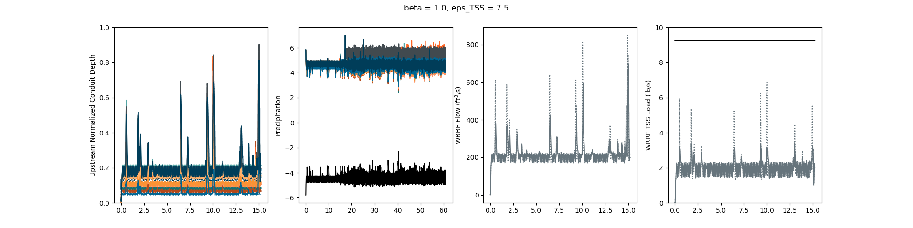
TSS

Slide 9

TSS

Slide 10
p = (sum(uparam*ustream) - sum(dparam*np.maximum(dstream-1.,np.zeros(len(dstream)))))/(1 + n_tanks)

Slide 13
p = (sum(uparam*ustream) + sum(dparam*np.maximum(dstream-1.,np.zeros(len(dstream)))))/(1 + n_tanks)

Slide 14
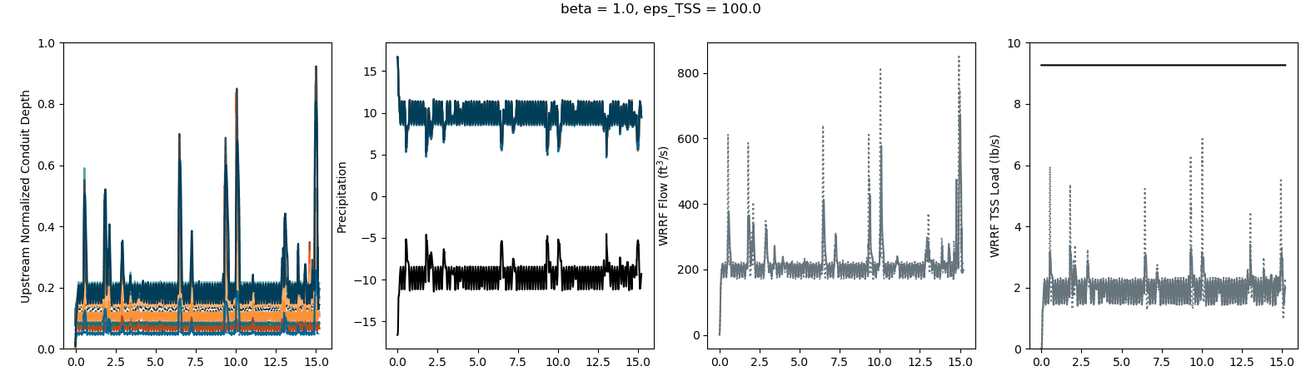
p = (sum(uparam*ustream) - sum(dparam*np.maximum(2.-dstream,np.zeros(len(dstream)))))/(1 + n_tanks)
Setpt 4.
Want to lower TSS peaks

Slide 15
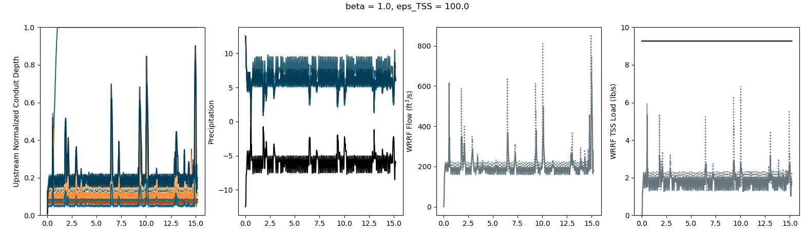
p = (sum(uparam*ustream) - sum(dparam*np.maximum(1.5-dstream,np.zeros(len(dstream)))))/(1 + n_tanks)
Setpt 4. (how much to release)
Lowering thres trigger actually raises peaks and lowers dry weather max
Setpt being to high will cause reaction to release to be too much

Slide 16
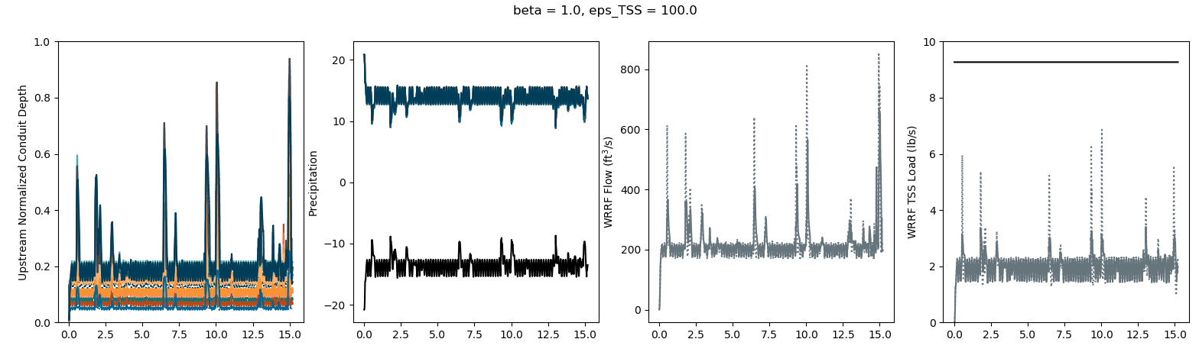
p = (sum(uparam*ustream) - sum(dparam*np.maximum(2.5-dstream,np.zeros(len(dstream)))))/(1 + n_tanks)
Setpt 4.
Want to lower TSS peaks a bit more

Slide 17
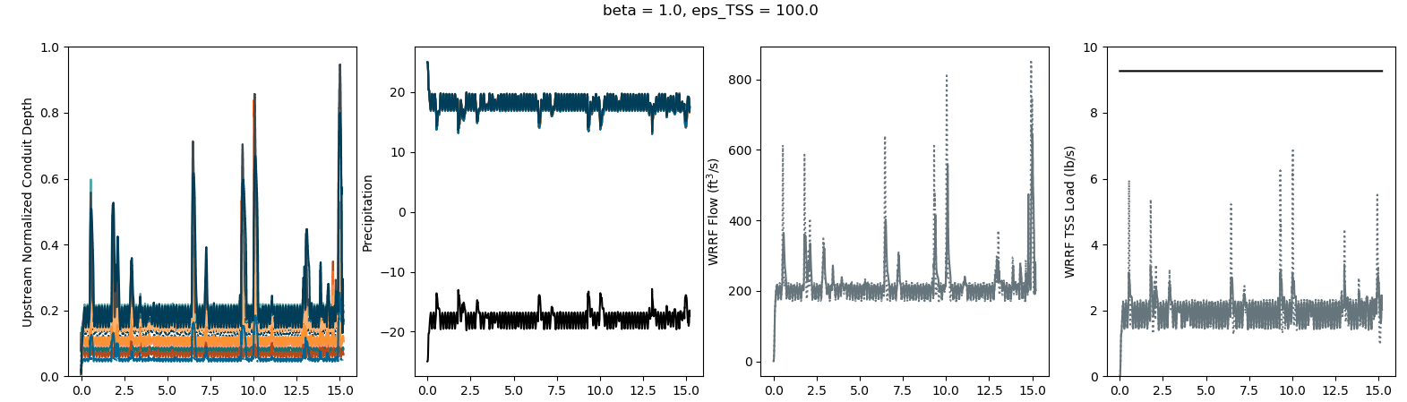
p = (sum(uparam*ustream) - sum(dparam*np.maximum(3.-dstream,np.zeros(len(dstream)))))/(1 + n_tanks)
Setpt 4.
Doesn’t seem to have lowered TSS peaks

Slide 18
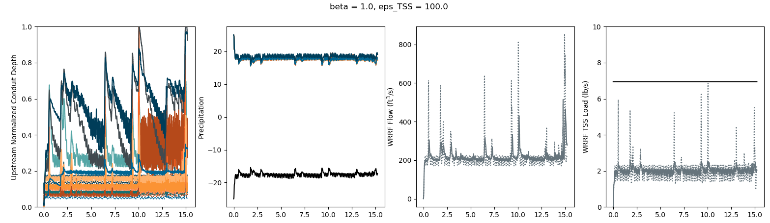
p = (sum(uparam*ustream) - sum(dparam*np.maximum(3.-dstream,np.zeros(len(dstream)))))/(1 + n_tanks)
Setpt 3.
Turning down release setpt helps reduce reactionary behavior a lot, but reduces max dry-weather; this may be as good as it gets; going to try 1) increasing threshold trigger and then 2) decreasing release setpt

Slide 19
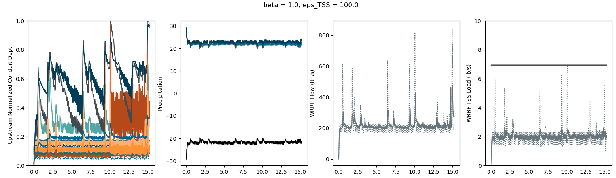
p = (sum(uparam*ustream) - sum(dparam*np.maximum(3.5-dstream,np.zeros(len(dstream)))))/(1 + n_tanks)
Setpt 3.
Minimal change; now to try decreasing release setpt

Slide 20
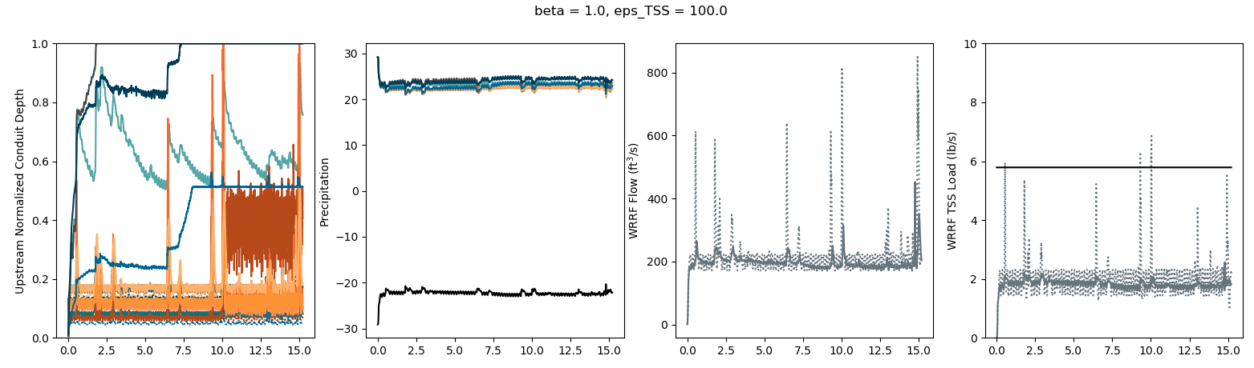
p = (sum(uparam*ustream) - sum(dparam*np.maximum(3.5-dstream,np.zeros(len(dstream)))))/(1 + n_tanks)
Setpt 2.5
Much smoother, but way too low; maybe try to switch from threshold to setpoint mode

Slide 21
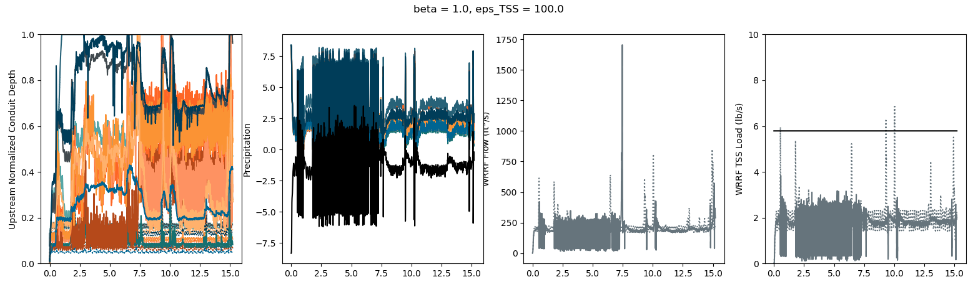
p = (sum(uparam*ustream) - sum(dparam*(1.-dstream)))/(1 + n_tanks)
Setpt 2.5
Too reactionary; try reducing release setpt

Slide 22
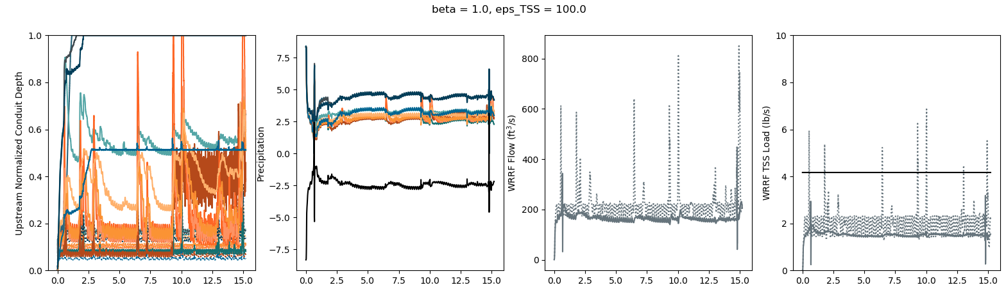
p = (sum(uparam*ustream) - sum(dparam*(1.-dstream)))/(1 + n_tanks)
Setpt 1.8
Still too reactionary, but steady-state too low; 1) decreasing release setpt and 2) increasing threshold trigger

Slide 23
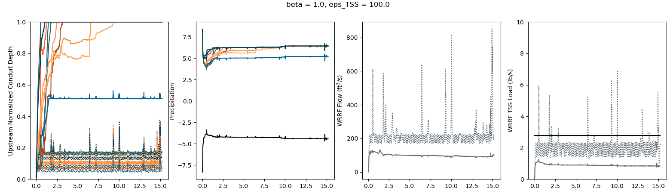
p = (sum(uparam*ustream) - sum(dparam*(1.-dstream)))/(1 + n_tanks)
Setpt 1.2
Ridiculously low; now to try increasing the threshold trigger

Slide 24
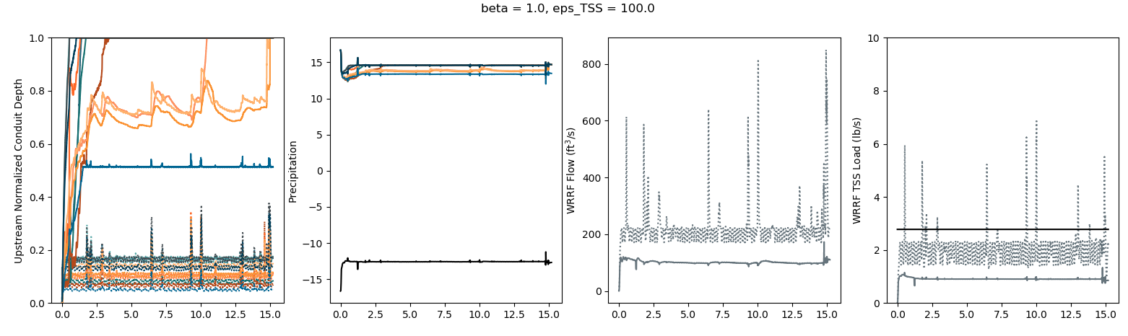
p = (sum(uparam*ustream) - sum(dparam*(2.-dstream)))/(1 + n_tanks)
Setpt 1.2
I don’t even know anymore

Slide 25
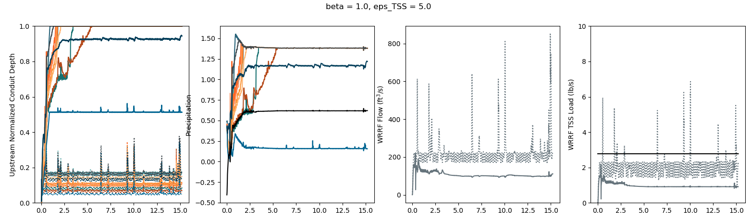
p = (sum(uparam*ustream) - sum(dparam*(1.-dstream)))/(1 + n_tanks)
Setpt 1.2
Trying with reducing the eps_TSS here

Slide 26
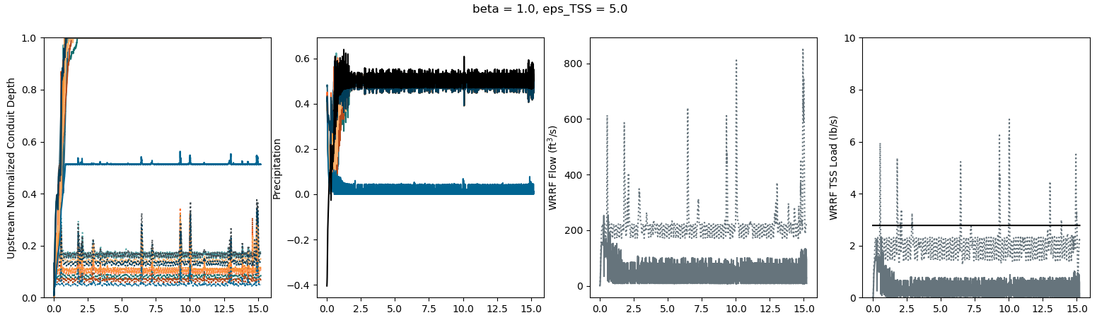
p = (sum(uparam*ustream) - sum(dparam*(1.-dstream)))/(1 + n_tanks)
Setpt 1.2
Getting rid of inflating uparam: uparam[i] = uparam[i] * (1+ustream[i])

Slide 27
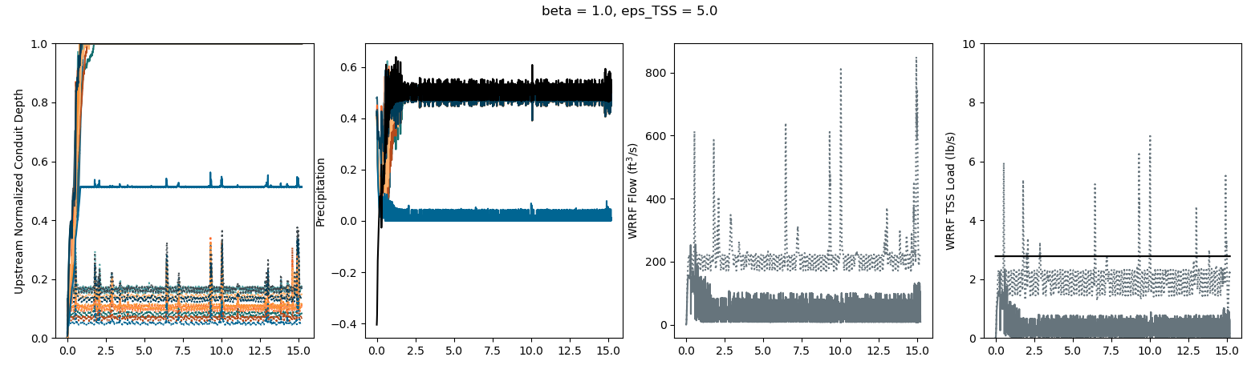
p = (sum(uparam*ustream) - sum(dparam*np.maximum(1.-dstream,np.zeros(len(dstream)))))/(1 + n_tanks)
Setpt 1.2
Trying it also with threshold instead of setpoint

Slide 28
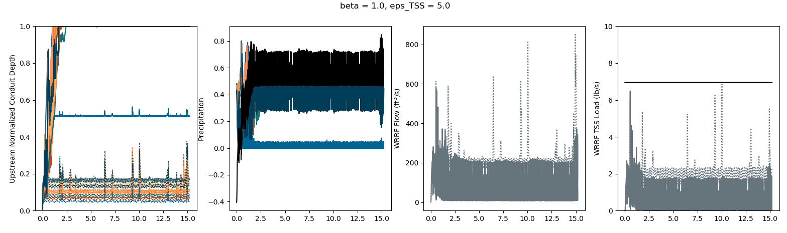
p = (sum(uparam*ustream) - sum(dparam*np.maximum(1.-dstream,np.zeros(len(dstream)))))/(1 + n_tanks)
Setpt 3.
Increasing release setpoint; just makes it flashier

Slide 29
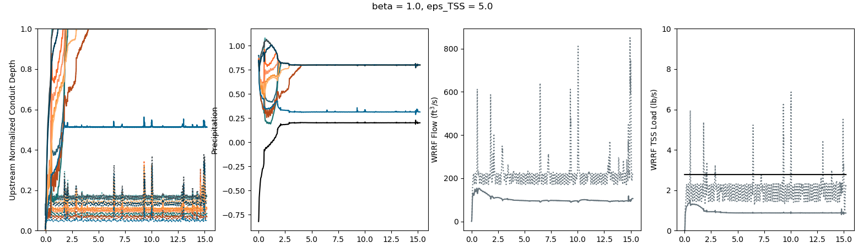
p = (sum(uparam*ustream) - sum(dparam*np.maximum(2.-dstream,np.zeros(len(dstream)))))/(1 + n_tanks)
Setpt 1.2
Increasing threshold trigger

Slide 30
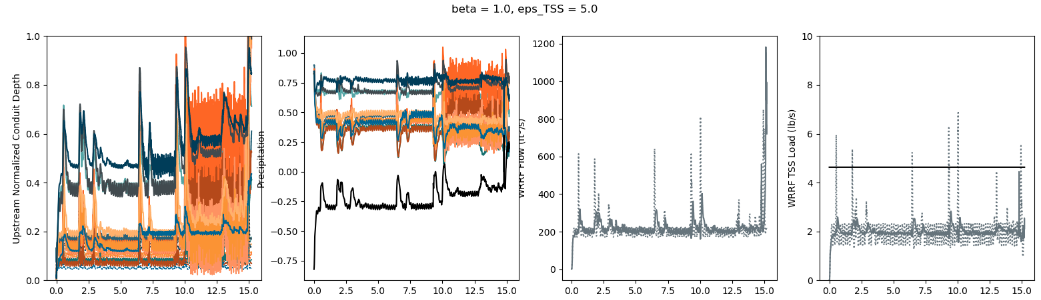
p = (sum(uparam*ustream) - sum(dparam*np.maximum(2.-dstream,np.zeros(len(dstream)))))/(1 + n_tanks)
Setpt 2.
Increasing release setpoint; ain’t bad

Slide 31
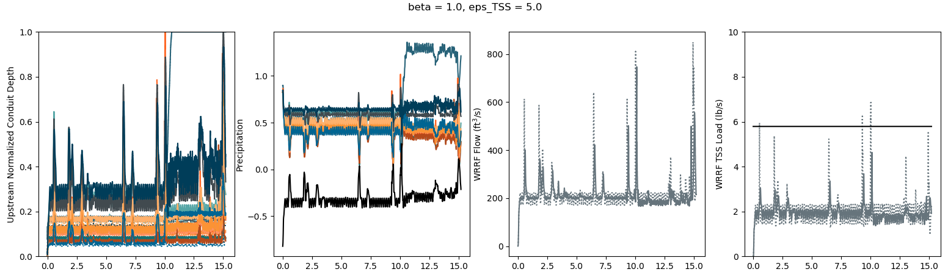
p = (sum(uparam*ustream) - sum(dparam*np.maximum(2.-dstream,np.zeros(len(dstream)))))/(1 + n_tanks)
Setpt 2.5
Increasing release setpoint a little bit more; a little flashy and flooding at day 10.0

Slide 32
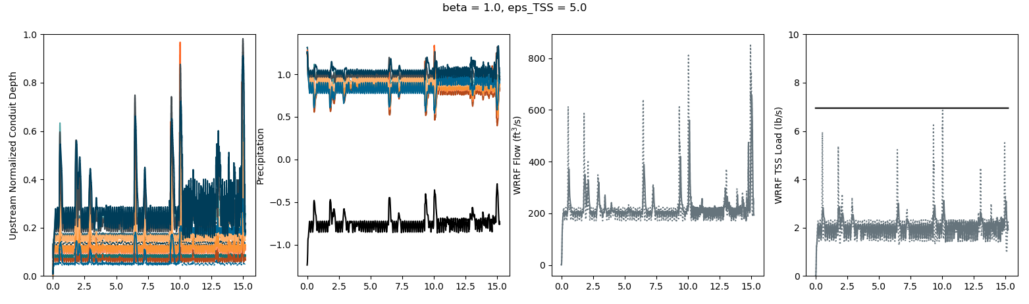
p = (sum(uparam*ustream) - sum(dparam*np.maximum(3.-dstream,np.zeros(len(dstream)))))/(1 + n_tanks)
Setpt 3.
Increase both release setpoint and threshold trigger; again, probably as good as it gets

Slide 33
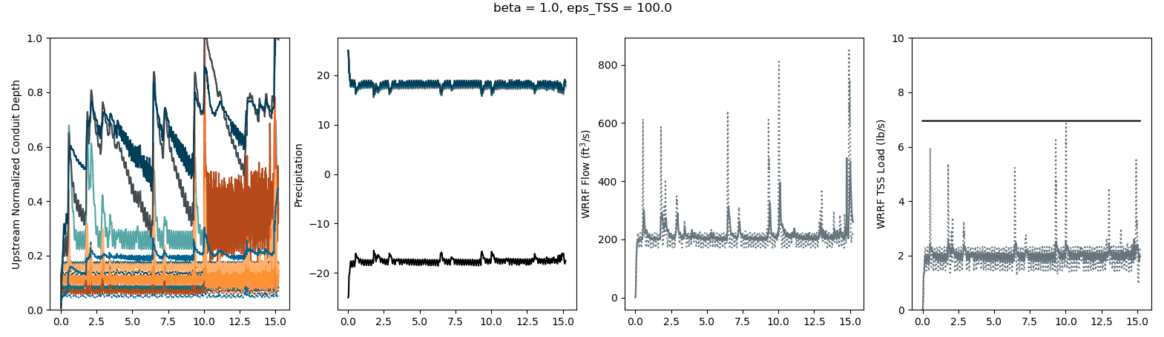
p = (sum(uparam*ustream) - sum(dparam*np.maximum(3.-dstream,np.zeros(len(dstream)))))/(1 + n_tanks)
Setpt 3.
Trying with eps_TSS = 100. to compare with slide 18

Slide 34
p = (sum(uparam*ustream) - sum(dparam*np.maximum(3.-dstream,np.zeros(len(dstream)))))/(1 + n_tanks)
Setpt 3.
COPY OF SLIDE 18
Turning down release setpt helps reduce reactionary behavior a lot, but reduces max dry-weather; this may be as good as it gets; going to try 1) increasing threshold trigger and then 2) decreasing release setpt
Little difference between with uparam adjustment (here) and without (previous slide), except in ustream depths because with adjustments we are releasing more water because PD is higher; there is also a slightly discernable increase in peaks with adjustments because of increased releases
WILL KEEP W/O ADJUSTMENTS

Slide 35
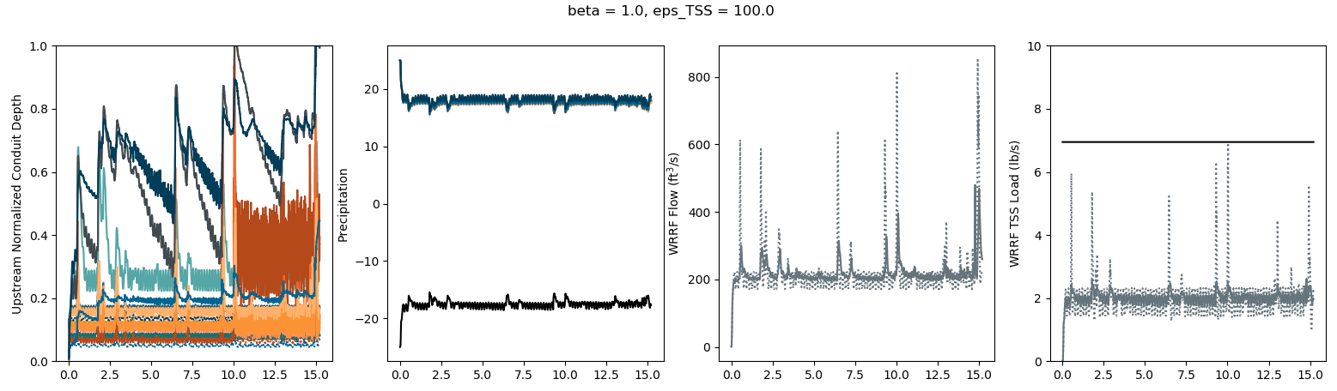
p = (sum(uparam*ustream) - sum(dparam*np.maximum(3.-dstream,np.zeros(len(dstream)))))/(1 + n_tanks)
Setpt 3.
Running with various eps_TSS values: 100.

Slide 36
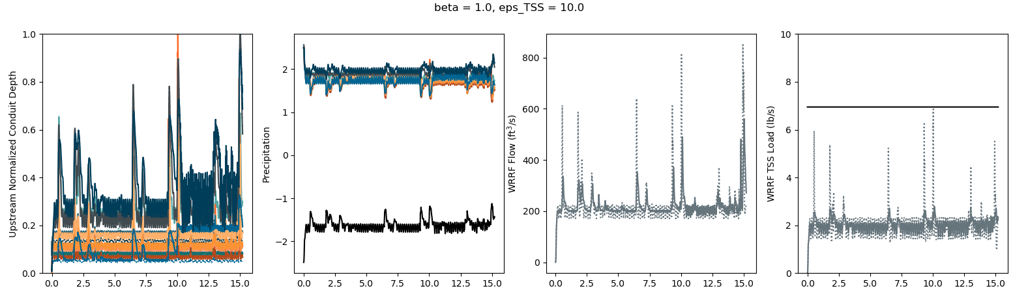
p = (sum(uparam*ustream) - sum(dparam*np.maximum(3.-dstream,np.zeros(len(dstream)))))/(1 + n_tanks)
Setpt 3.
Running with various eps_TSS values: 10.

Slide 37

p = (sum(uparam*ustream) - sum(dparam*np.maximum(3.-dstream,np.zeros(len(dstream)))))/(1 + n_tanks)
Setpt 3.
Running with various eps_TSS values: 8.

Slide 38
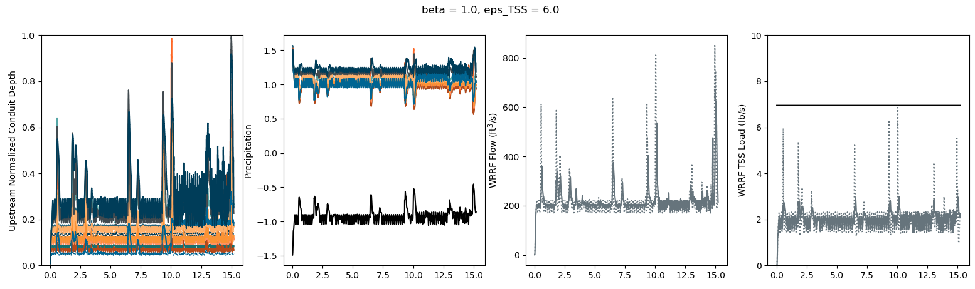
p = (sum(uparam*ustream) - sum(dparam*np.maximum(3.-dstream,np.zeros(len(dstream)))))/(1 + n_tanks)
Setpt 3.
Running with various eps_TSS values: 6.

Slide 39
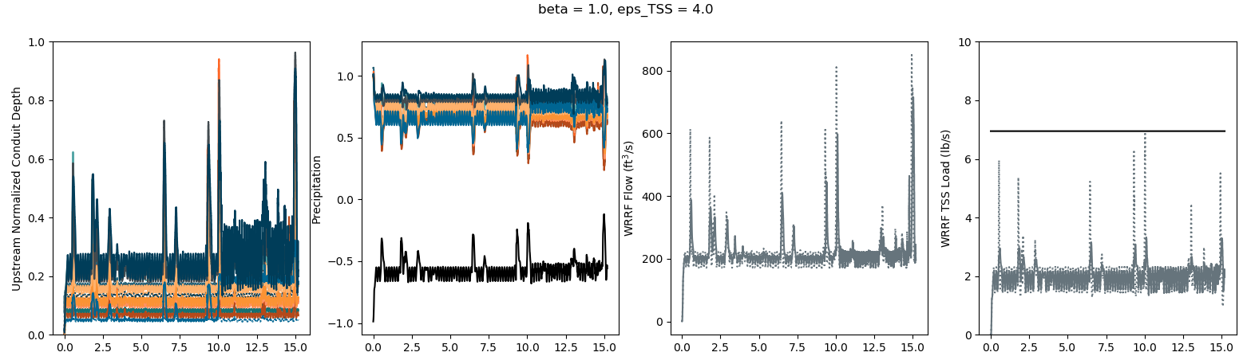
p = (sum(uparam*ustream) - sum(dparam*np.maximum(3.-dstream,np.zeros(len(dstream)))))/(1 + n_tanks)
Setpt 3.
Running with various eps_TSS values: 4.

Slide 40
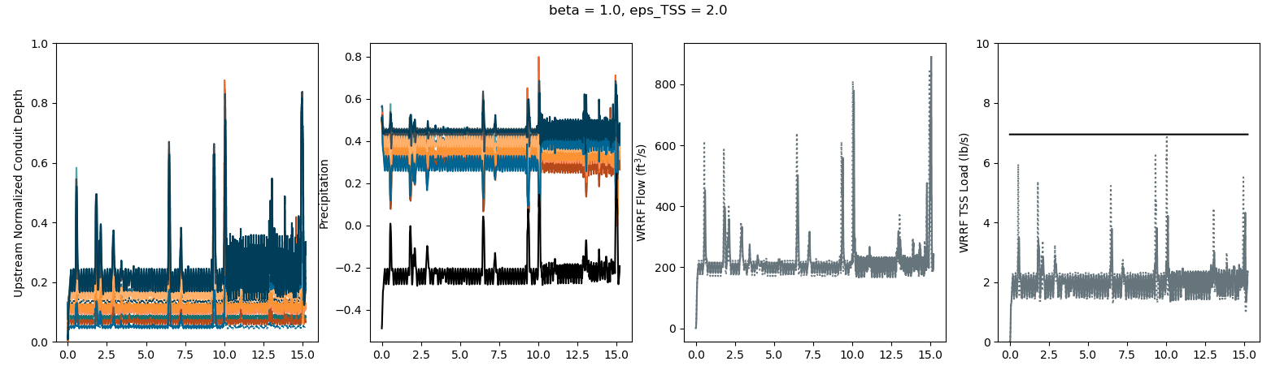
p = (sum(uparam*ustream) - sum(dparam*np.maximum(3.-dstream,np.zeros(len(dstream)))))/(1 + n_tanks)
Setpt 3.
Running with various eps_TSS values: 2.

Slide 41
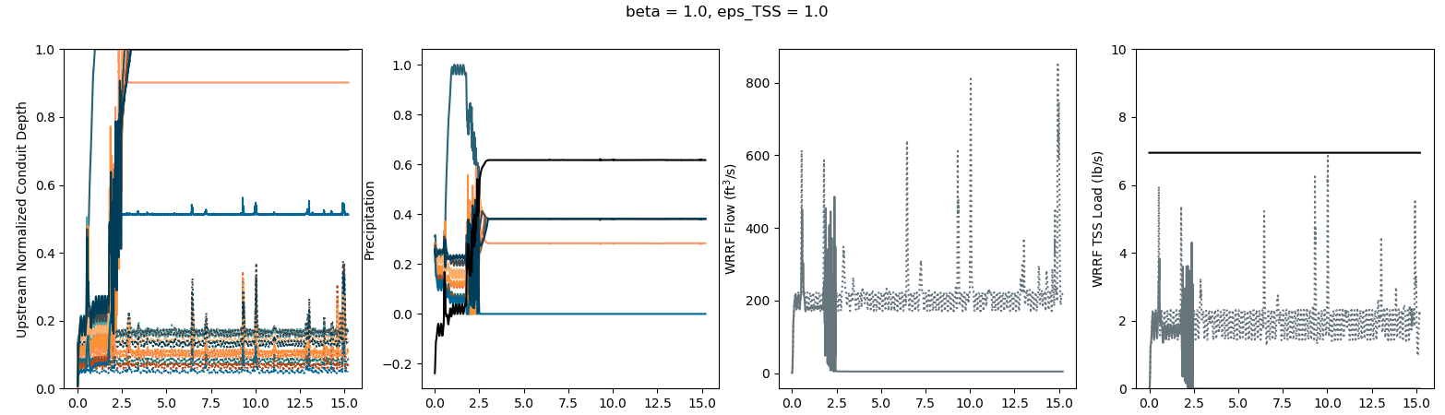
p = (sum(uparam*ustream) - sum(dparam*np.maximum(3.-dstream,np.zeros(len(dstream)))))/(1 + n_tanks)
Setpt 3.
Running with various eps_TSS values: 1.
It shouldn’t be doing this dropping thing; I think it’s because of how the PD is defined to be uparam*ustream-p

Slide 42
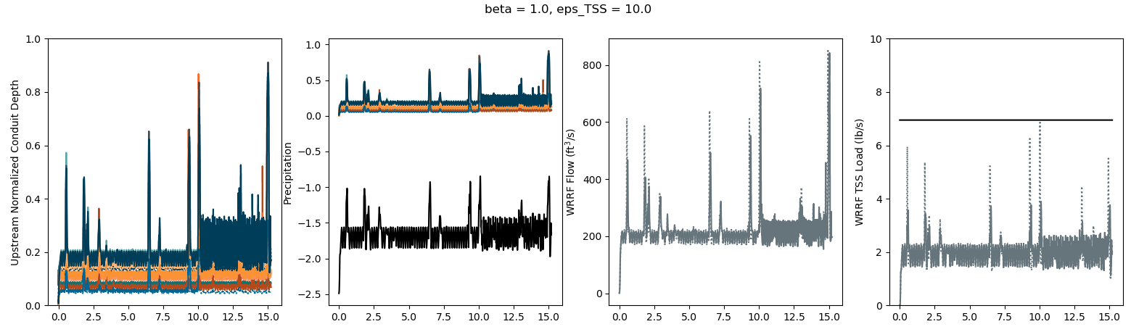
p = (sum(uparam*ustream) - sum(dparam*np.maximum(3.-dstream,np.zeros(len(dstream)))))/(1 + n_tanks)
Setpt 3.
Increased eps_TSS and now to decrease the release setpt and threshold trigger

Slide 43
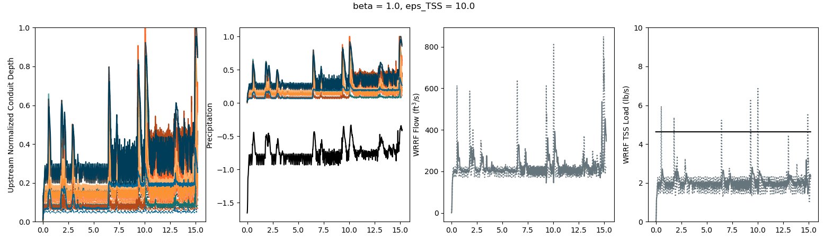
p = (sum(uparam*ustream) - sum(dparam*np.maximum(2.-dstream,np.zeros(len(dstream)))))/(1 + n_tanks)
Setpt 2.
Decreasing release setpoint and threshold trigger

Slide 44
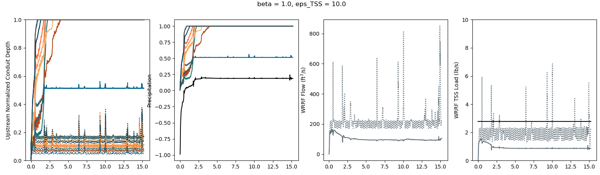
p = (sum(uparam*ustream) - sum(dparam*np.maximum(1.2-dstream,np.zeros(len(dstream)))))/(1 + n_tanks)
Setpt 1.2
Try decreasing again for kicks

Slide 45
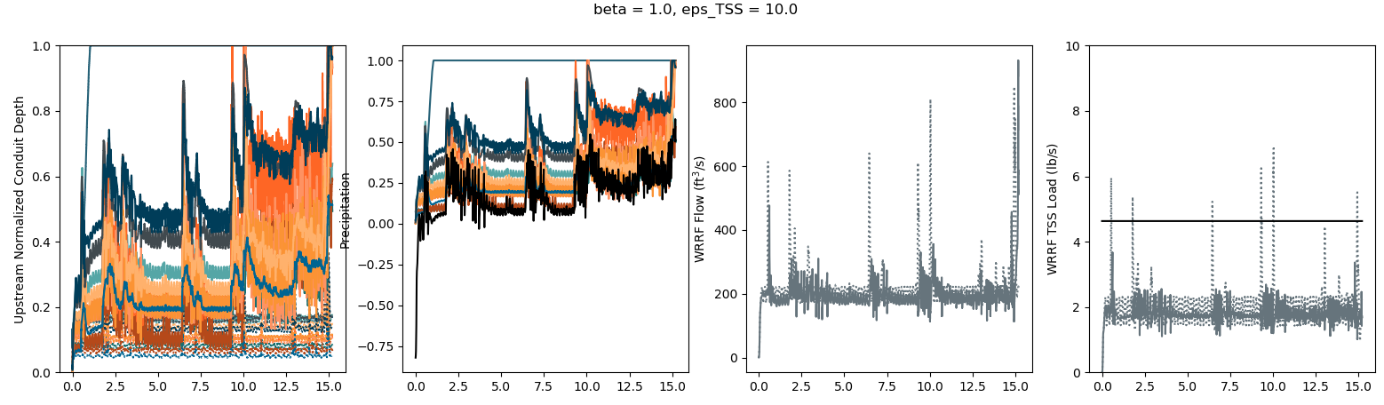
p = (sum(uparam*ustream) - sum(dparam*np.maximum(1.-dstream,np.zeros(len(dstream)))))/(1 + n_tanks)
Setpt 2.
Keeping threshold trigger at 1. and increasing release setpoint

Slide 46
p = (sum(uparam*ustream) - sum(dparam*np.maximum(2.-dstream,np.zeros(len(dstream)))))/(1 + n_tanks)
Setpt 2.
Going back to here (slide 43) and now to try different eps_TSS values

Slide 47
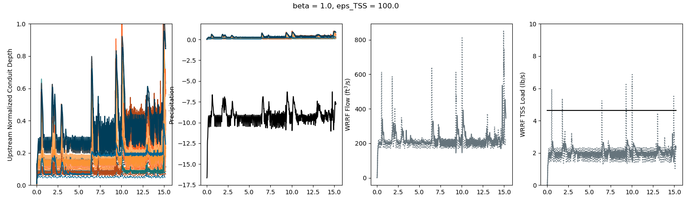
p = (sum(uparam*ustream) - sum(dparam*np.maximum(2.-dstream,np.zeros(len(dstream)))))/(1 + n_tanks)
Setpt 2.
d

Slide 48
p = (sum(uparam*ustream) - sum(dparam*np.maximum(2.-dstream,np.zeros(len(dstream)))))/(1 + n_tanks)
Setpt 2.
d

Slide 49
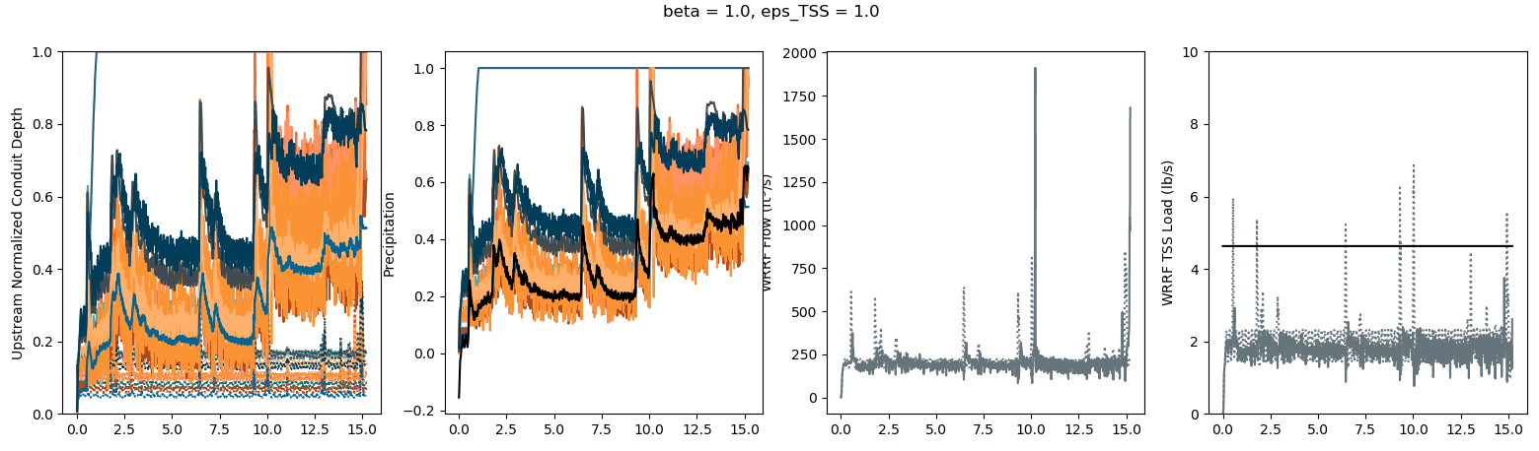
p = (sum(uparam*ustream) - sum(dparam*np.maximum(2.-dstream,np.zeros(len(dstream)))))/(1 + n_tanks)
Setpt 2.
d

Slide 50
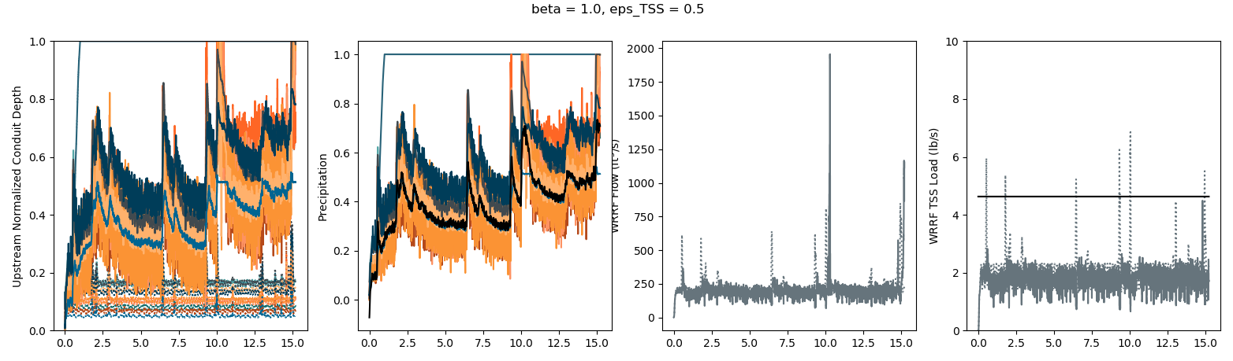
p = (sum(uparam*ustream) - sum(dparam*np.maximum(2.-dstream,np.zeros(len(dstream)))))/(1 + n_tanks)
Setpt 2.
d

Slide 51
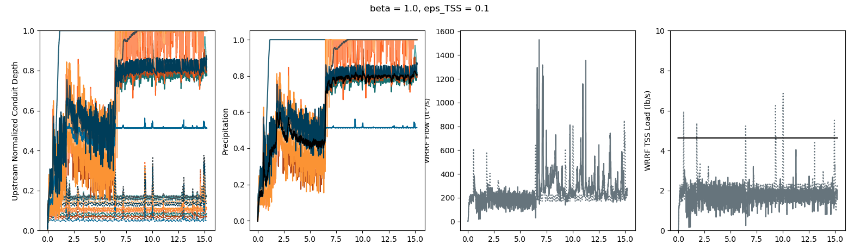
p = (sum(uparam*ustream) - sum(dparam*np.maximum(2.-dstream,np.zeros(len(dstream)))))/(1 + n_tanks)
Setpt 2.
d

Slide 52
Try a couple of options with varying eps_TSS values:
Slide 18
With uparam adjustment: uparam[i] = uparam[i] * (1+ustream[i])
Release setpoint: 3.
Threshold trigger: 3.
Setpoint threshold: 1 p = (sum(uparam*ustream) - sum(dparam*np.maximum(3.-dstream,np.zeros(len(dstream)))))/(1 + n_tanks)
PD computed with price term: PD[i] = max(-p + uparam[i]*ustream[i],0.)
Slide 18 - augment
With uparam adjustment: uparam[i] = uparam[i] * (1+ustream[i])
Release setpoint: 2.
Threshold trigger: 2.
Setpoint threshold: 1 p = (sum(uparam*ustream) - sum(dparam*np.maximum(2.-dstream,np.zeros(len(dstream)))))/(1 + n_tanks)
PD computed with price term: PD[i] = max(-p + uparam[i]*ustream[i],0.)
Slide 30
Without uparam adjustment: constant and unchanged for all upstream assets regardless of state
Release setpoint: 2.
Threshold trigger: 2.
Setpoint threshold: 1 p = (sum(uparam*ustream) - sum(dparam*np.maximum(2.-dstream,np.zeros(len(dstream)))))/(1 + n_tanks)
PD computed with price term: PD[i] = max(-p + uparam[i]*ustream[i],0.)

Slide 53
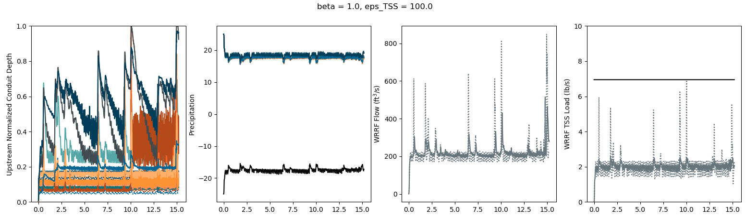
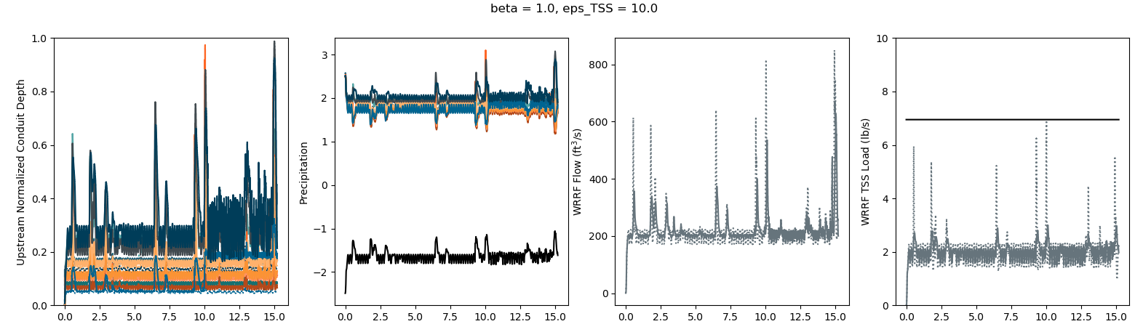
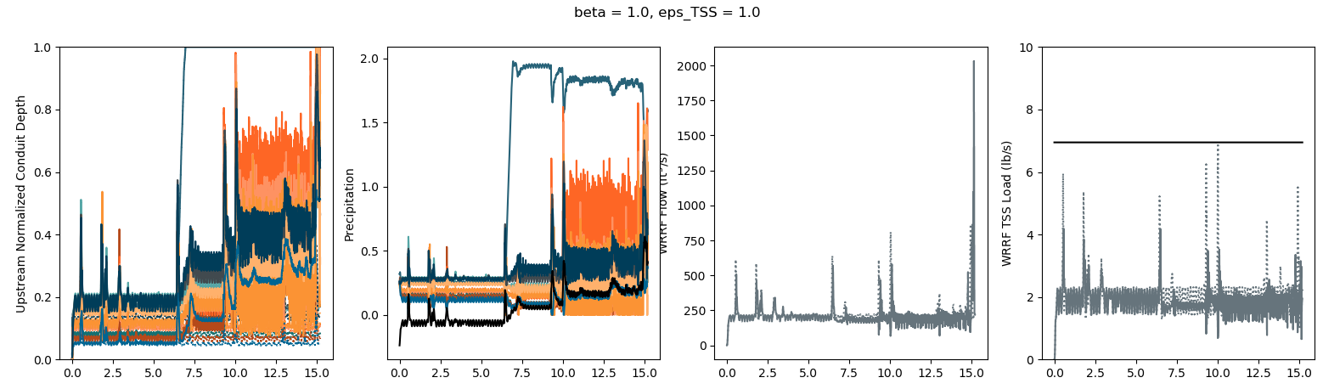
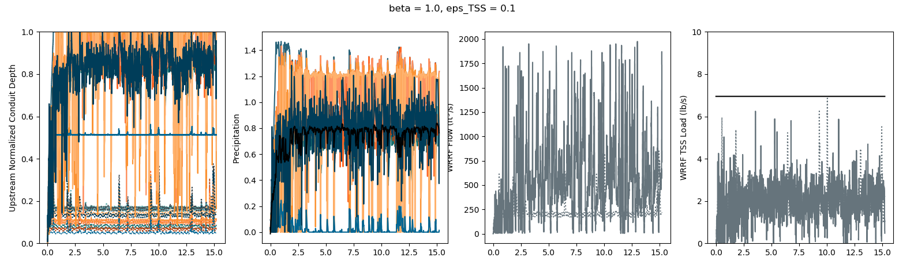
Slide 18

Slide 54
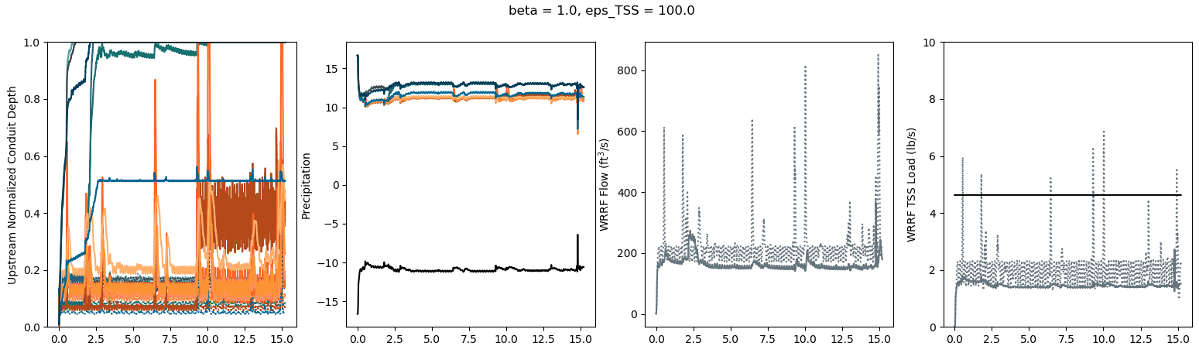
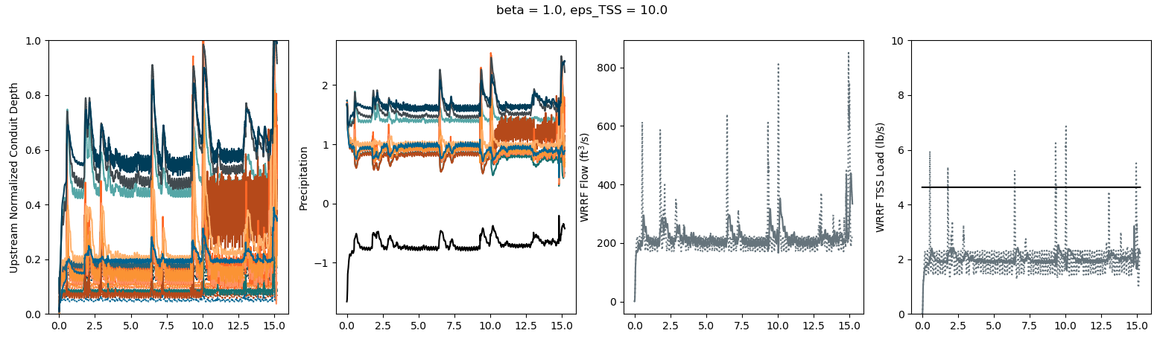
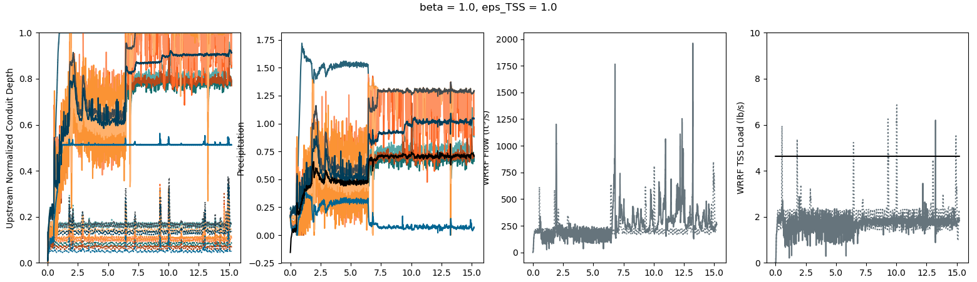
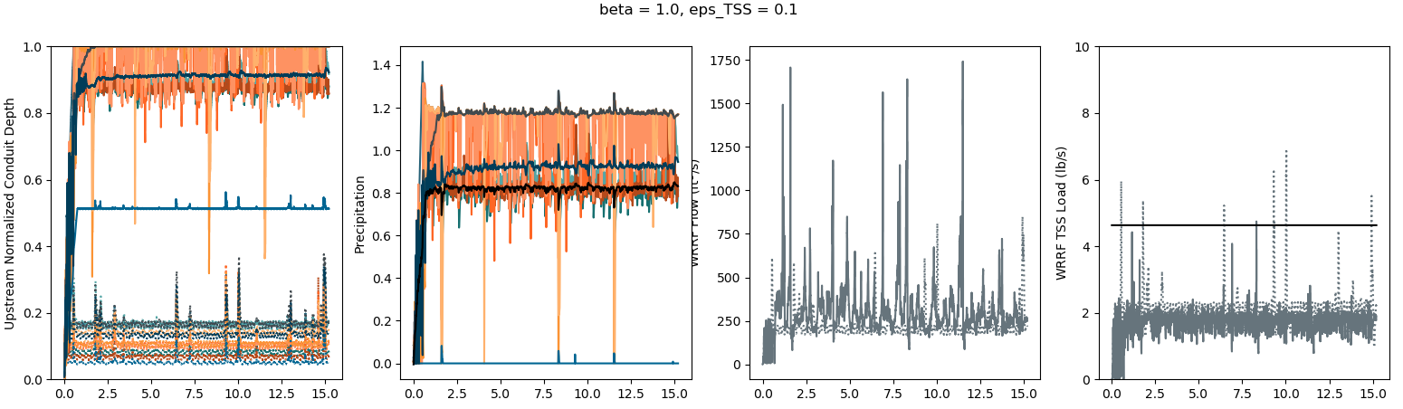
Slide 18 - augment

Slide 55




Slide 30

Slide 56



Slide 30
Narrower look at eps_TSS values

Slide 57



Slide 30
Narrower look at eps_TSS values

Slide 58
Sticking with Slide 18 – augment for TSS
Now to find the best flow setpt value

Slide 59

Setpt = 3.2
Too high of peaks

Slide 60

Setpt = 2.5
Better, but try lower

Slide 61

Setpt = 2.
Try a little higher?

Slide 62

Setpt = 2.2
Try both 2. and 2.2 with higher eps_q

Slide 63

Setpt = 2.2
X

Slide 64

Setpt = 2.
X

Slide 65

Setpt = 1.8
Trying again back to eps_q = 10

Slide 66
Do setpt = 2. for flow

